Slide 1

VOTING SYSTEM
CPPS MINI PROJECT
Guided By : Prof. Savita Kumbhare
Made By :
Amaan S Tamboli J1043
Om P Bidve J1064
Saish S Kothawade J1067
Yash M Salunke J1019
Ajay S Shendage J1030

Slide 2
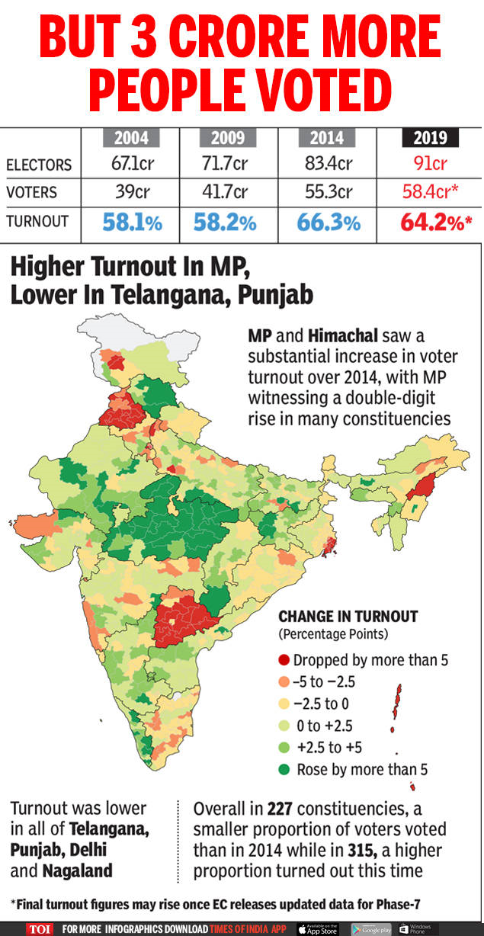
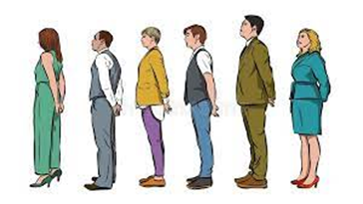

PROBLEM STATEMENT
The importance of voting is lost amongst the hustle and bustle of city life.
The highest recorded voter turnout in India was recorded in 2014 for the Lok Sabha elections at 66.4%
People need to stand in a queue for hours for their chance to vote. Old aged or people having disability because of this they cannot wait in Long Queue.
In hot country such as India, it becomes very difficult to stand in queues for longer period
It becomes difficult for senior citizens to get out of their home and go to the voting centres to cast their vote.
Indian general elections are one of the most expensive elections. The last elections costed around Rs. 50000 crore!

Slide 3



SOLUTION PROPOSED
Voting online saves time and eases vote management
Quick and easy — full-service setup and management saves you time, so you can work on other projects
Automatic vote tallying — no manual counts of paper ballots
Accurate — no duplicate or invalidated ballots
No waiting for results — real-time results, no waiting for ballots in the mail
Electronic voting is private and secure
Private — our third-party service provides a layer of separation between the voting process and individuals involved
Secure — no unsecured paper ballots
Electronic voting is environment friendly
100% Green friendly — not a single tree is harmed in this easy to use electronic voting process!

Slide 4
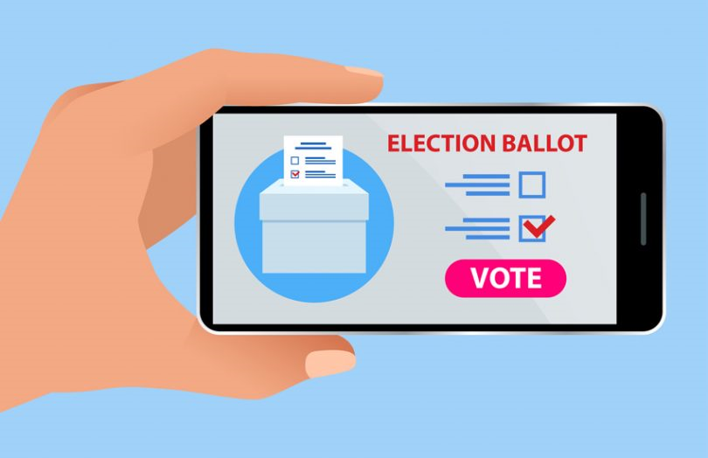

SOLUTION PROPOSED
Getting to know that everything is going digital, so why not voting can be practiced digitally!
TIME???
BENEFITS:-
Electronic voting maximizes participation:
Easy and efficient — takes only a minute or two to vote
Convenient — people can vote online when it suits them - there's no ballot to mail or meeting to attend
Higher response rates — email reminders and online convenience boost participation for busy owners
Voting online saves money
No supply costs — no paper ballots, no postage and no printing
No equipment — 100% hosted and electronic
Automated — no time or resources needed for manual hand counts
Cost-effective — conduct multiple votes annually
CO$T???
QUALITY??

Slide 5
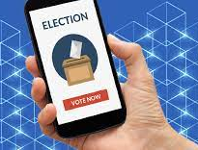


WHAT OUR PROGRAM CONTAINS?
Info. To cast a vote
2. Real time voter count
3. Real time leading Candidate
4. Change in of vote
5.Next voter

Slide 6
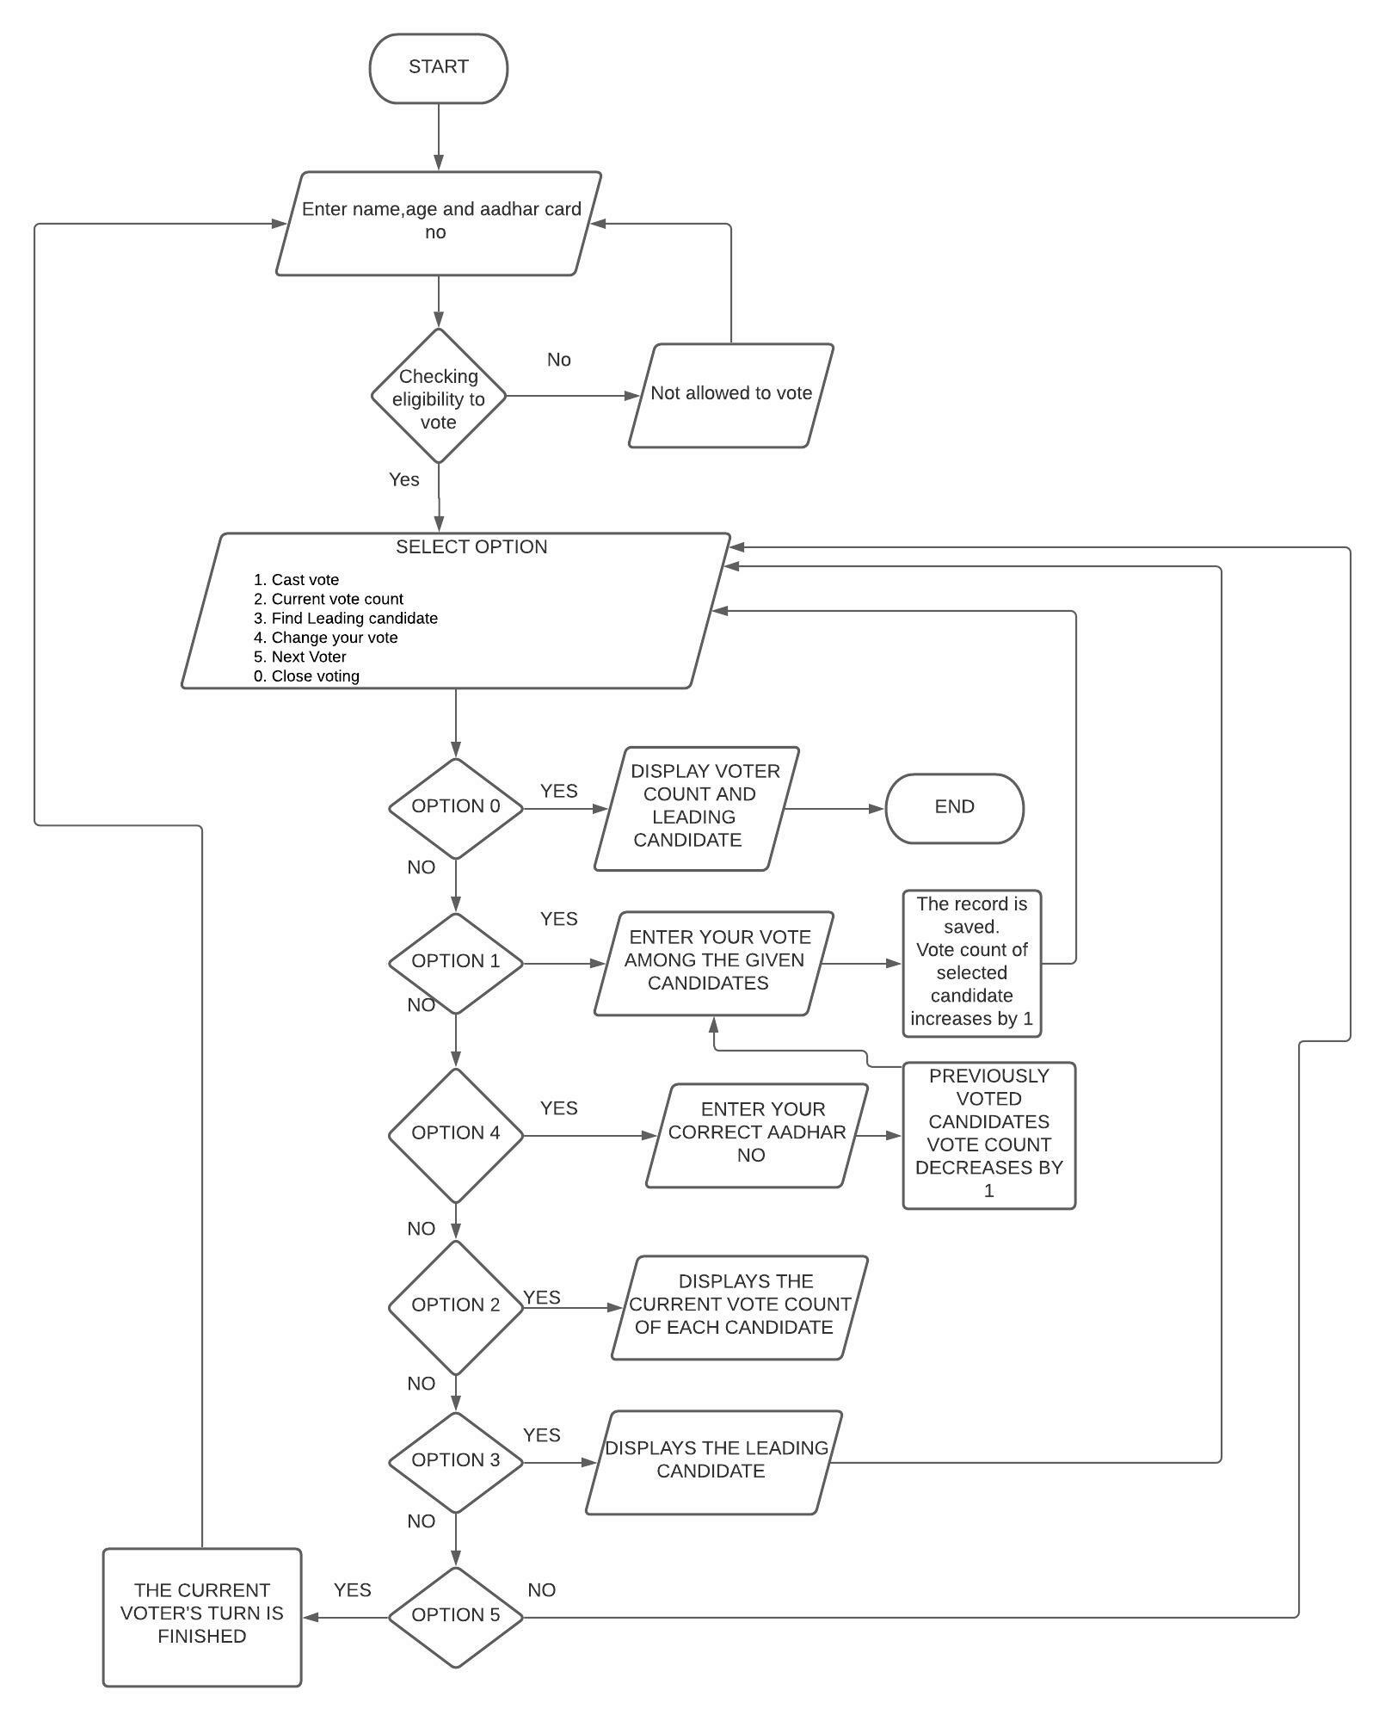
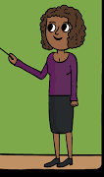
FLOWCHART
??????

Slide 7
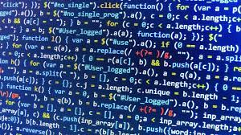
OUTPUT(PROGRAM)

Slide 8
THANK YOU AND HAPPY VOTING…!

